Slide 1
Memecoin Case Study
Max Johnson

Slide 2
Pre-investigation Data Processing/Cleaning

Slide 3
Data processing/cleaning steps
Utilize CoinGecko API to retrieve list of 10,000 coins with name, id, symbol data–to be used for name→id conversions for necessary datasets
Get all coin categories from token-categories.csv and convert coin names to coingecko ids with above coin list
Create list of all tokens that have been in top 100 during at least one quarter since 2020 using top100.xlsx (247)
Classify each token into a category–if categorized as a memecoin in ‘Tier II Sector,’ then considered a memecoin, otherwise used ‘Tier I Sector.’ All tokens not on the list are placed in ‘n.a.’
Pair each token/coin with pricing data from prices.csv

Slide 4
Data Filtration
Filtered to 2020- for more complete/relevant data
Used 12 different categories for token returns data identified by three letters:
First letter–last, median, average (l,m,a)--technique for weekly/monthly price determination
Second letter–weekly, monthly (w,m)--time for price aggregation
Third letter–average, median (a, m)--technique used for whole category returns
Used percent change to calculate returns between weeks/months

Slide 5
Looking back historically, is significant outperformance of the memecoin category a good or bad indicator for the forward performance of crypto markets?

Slide 6
Outperformance of the Memecoin Category
Determine weekly/monthly returns for each category (12 methods lwa, lwm, mwa, mwm, awa, awm, lma, lmm, mma, mmm, ama, amm)
Filter based on weeks/months the memecoin category produced greater returns than the market as a whole
Establish a correlation between week of memecoin outperformance, and following week of market returns. Follow same process for month of outperformance and month of market returns
Check other possible variables

Slide 7
OLS Regression: Memecoin Returns vs Following Week Market Returns
For almost every single regression done, the ‘last price’ method (lw) returned a high p-value >0.4 (makes sense due to volatility)
Average/median weekly market returns indicated a weak yet positive and statistically significant correlation
Note: could be due to market bull runs
week | t-value | p-value
lwa | 0.244 | 0.808
lwm | 0.131 | 0.896
mwa | 4.241 | 0.000
mwm | 3.356 | 0.001
awa | 4.241 | 0.000
awm | 2.736 | 0.008
month | t-value | p-value
lma | 2.787 | 0.010
lmm | 1.955 | 0.062
mma | 0.935 | 0.360
mmm | 0.256 | 0.800
ama | 0.935 | 0.360
amm | 0.494 | 0.626

Slide 8
OLS Regression: Market Returns Week of Outperformance vs Following Week Market Returns
To account for possible market runs, check correlation between ‘current’ market returns vs the following week’s
Produced similar results as before (monthly vs weekly)
Note: memecoin performance carrying market returns?
week | t-value | p-value
lwa | 0.248 | 0.805
lwm | -0.680 | 0.498
mwa | 3.848 | 0.000
mwm | 1.614 | 0.110
awa | 3.344 | 0.001
awm | 2.666 | 0.009
month | t-value | p-value
lma | 2.995 | 0.006
lmm | 2.400 | 0.024
mma | 2.989 | 0.007
mmm | 2.382 | 0.025
ama | 3.047 | 0.006
amm | 2.955 | 0.007

Slide 9
OLS Regression: Memecoin Returns vs Following Week Market Returns Excluding Memecoins
Check how memecoin performance correlates with performance of every other coin
Produced similar results as before correlation to whole market
week | t-value | p-value
lwa | 0.232 | 0.817
lwm | 0.123 | 0.902
mwa | 4.235 | 0.000
mwm | 3.352 | 0.001
awa | 2.764 | 0.007
awm | 2.728 | 0.008
month | t-value | p-value
lma | 3.104 | 0.005
lmm | 1.936 | 0.064
mma | 1.051 | 0.304
mmm | 0.254 | 0.801
ama | 1.275 | 0.215
amm | 0.485 | 0.632

Slide 10
OLS Regression: Memecoin Returns and Market w/o Memecoins vs Following Week Market Returns
Memecoin
Market w/o memecoins
week | t-value | p-value
lwa | 0.209 | 0.835
lwm | 0.223 | 0.824
mwa | 3.642 | 0.000
mwm | 3.091 | 0.003
awa | 2.066 | 0.042
awm | 2.073 | 0.041
month | t-value | p-value
lma | 1.838 | 0.080
lmm | 1.028 | 0.314
mma | -1.051 | 0.305
mmm | -1.400 | 0.174
ama | -1.420 | 0.169
amm | -2.250 | 0.034
week | t-value | p-value
lwa | 0.162 | 0.872
lwm | -0.709 | 0.480
mwa | 1.646 | 0.103
mwm | 1.052 | 0.295
awa | 2.238 | 0.028
awm | 1.960 | 0.053
month | t-value | p-value
lma | 1.689 | 0.105
lmm | 1.667 | 0.108
mma | 3.210 | 0.004
mmm | 2.795 | 0.010
ama | 3.200 | 0.004
amm | 3.879 | 0.001
Shows that neither memecoins nor the rest of the market has an insignificant correlation with future market returns (mainly weekly)

Slide 11
OLS Regression: Memecoin Returns Compared to Expected Return vs Following Week Market Returns Compared to Expected Return
Correlation between how memecoins and the market performed compared to their expected returns
Significant, positive correlation
There is a relationship between memecoins outperforming expectation and the market outperforming expectation
week | t-value | p-value
lwa | 2.229 | 0.027
lwm | 1.625 | 0.106
mwa | 6.721 | 0.000
mwm | 1.990 | 0.048
awa | 3.807 | 0.000
awm | 3.193 | 0.002
month | t-value | p-value
lma | 3.306 | 0.002
lmm | 2.452 | 0.018
mma | 5.576 | 0.000
mmm | 4.027 | 0.000
ama | 6.755 | 0.000
amm | 5.208 | 0.000

Slide 12
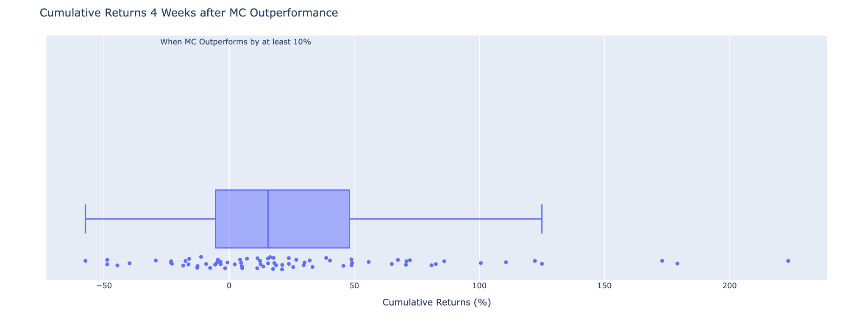
Good or Bad Indicator for Crypto Market?
There is a positive correlation between returns from weeks of memecoins outperforming the market and the market’s returns the following week ⇒ it may be a good indicator for forward performance of crypto market
For reference: box plot of the cumulative market returns 4 weeks after a week of memecoin market-outperformance
Mean and median are positive
Many data points lie negative
Significant correlation between memecoins outperforming expectation and the market outperforming expectation – Possible good indicator?

Slide 13
How normal/abnormal is memecoin outperformance? In your answer, include the number of weeks since the beginning of (2020 YEAR) that memecoins have been the top performing sector?

Slide 14
Weeks of Memecoins as Top-Performing Sector
The number of weeks was determined by counting weeks in which the memecoin category had higher returns than every other category
Returns determined through six different methods (lwa, lwm, mwa, mwm, awa, awm)
Between the six methods, the number of weeks averaged to about 44 weeks from 2020 to the most recent price data

Slide 15
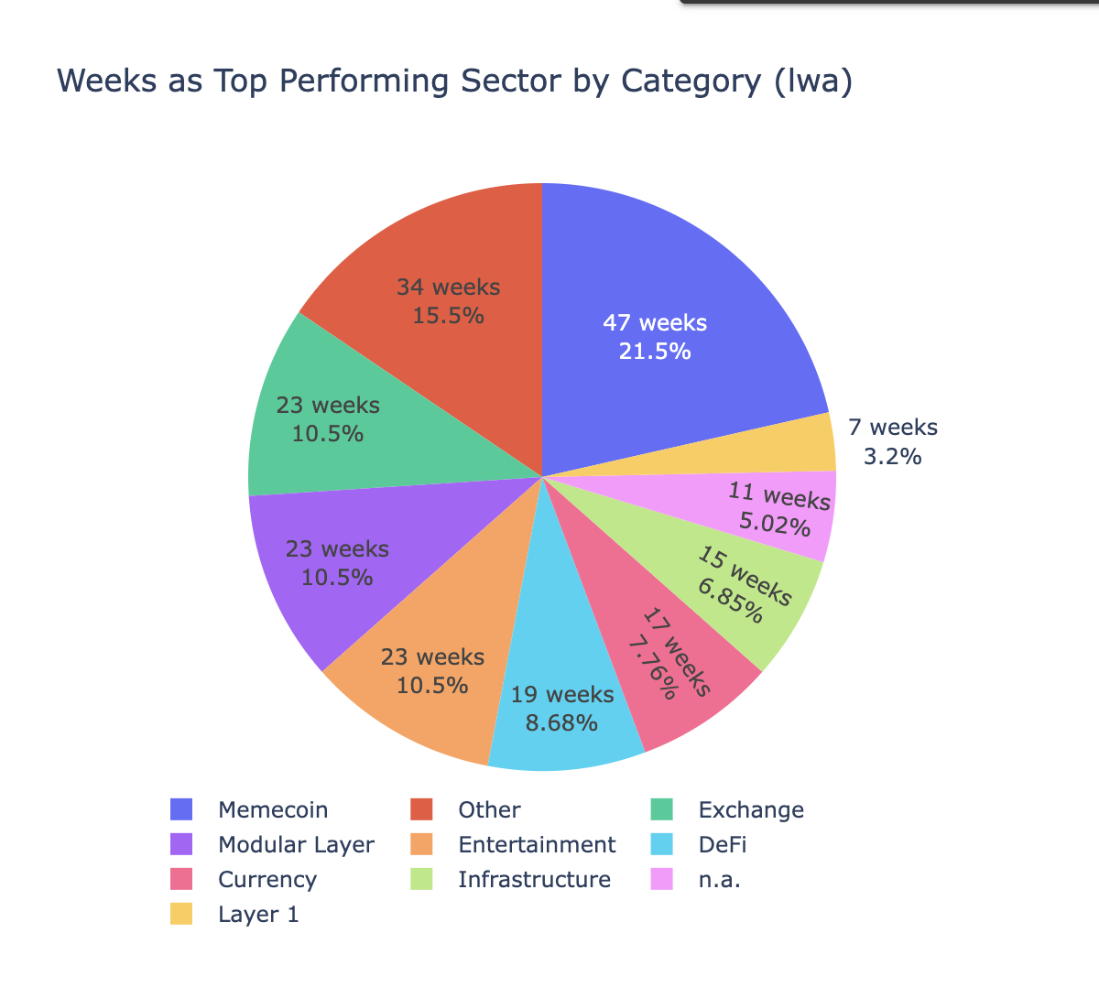
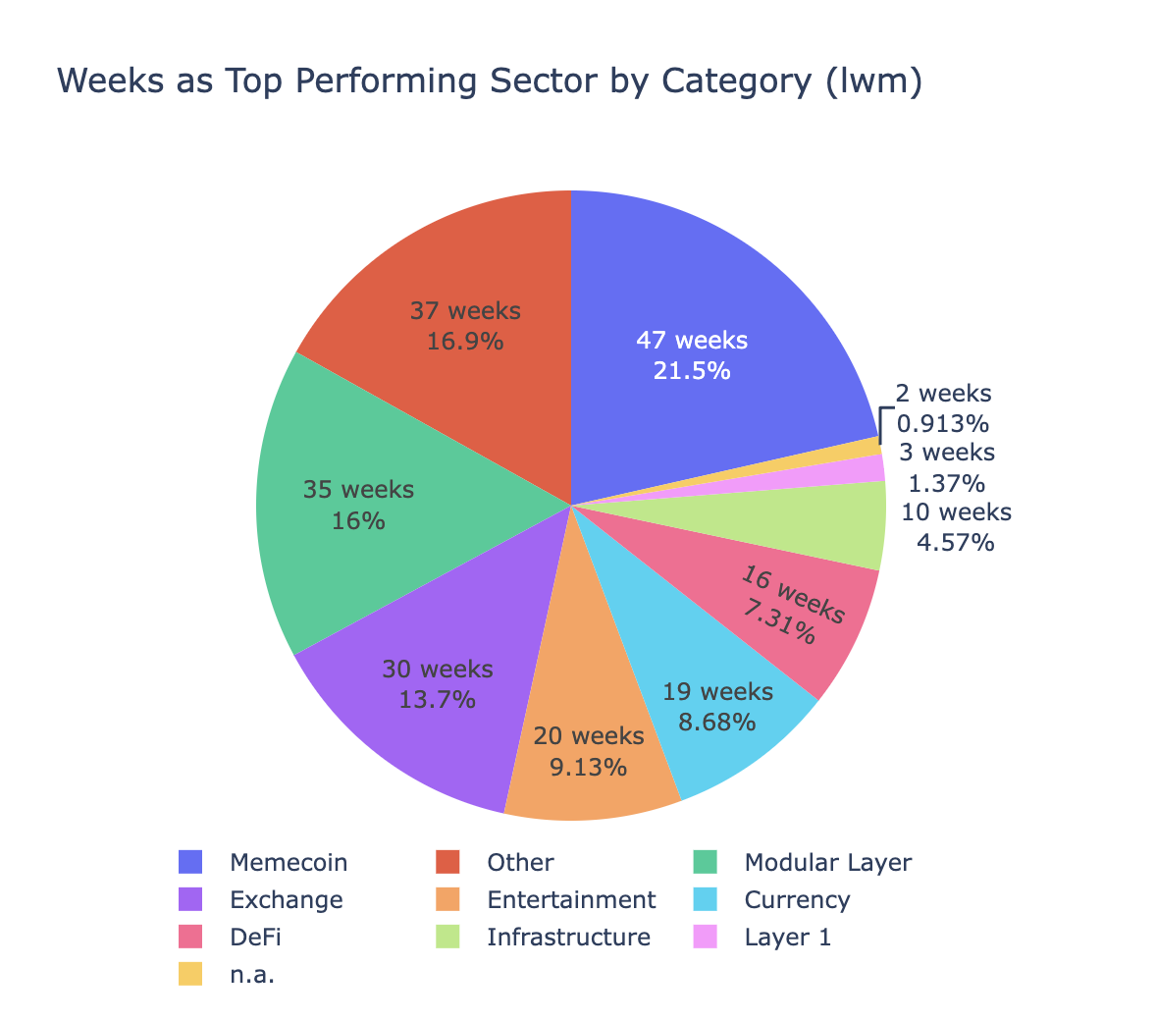
Returns using last weekly price (avg, med for category)

Slide 16
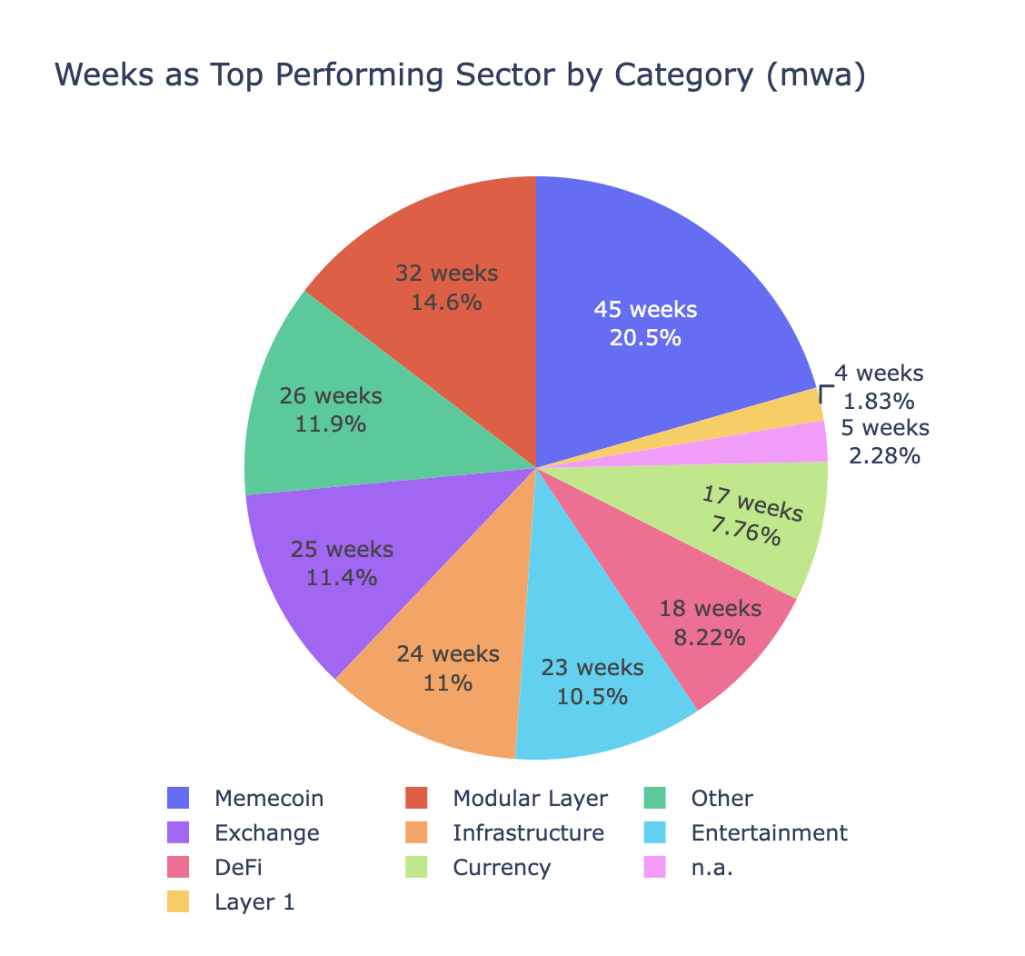
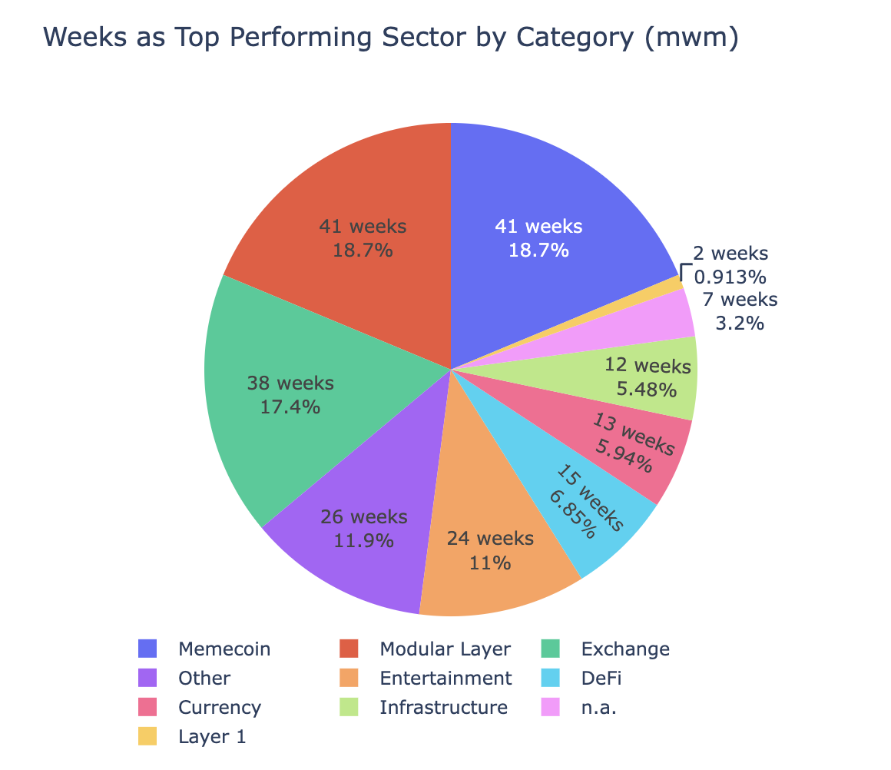
Returns using median weekly price (avg, med for category)

Slide 17
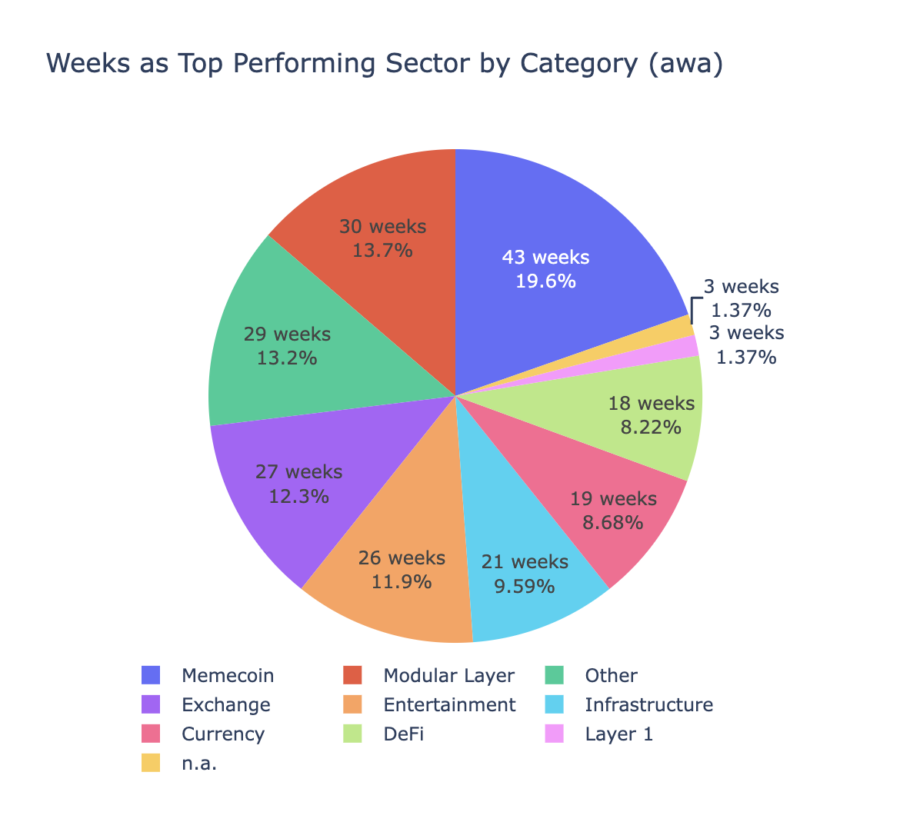
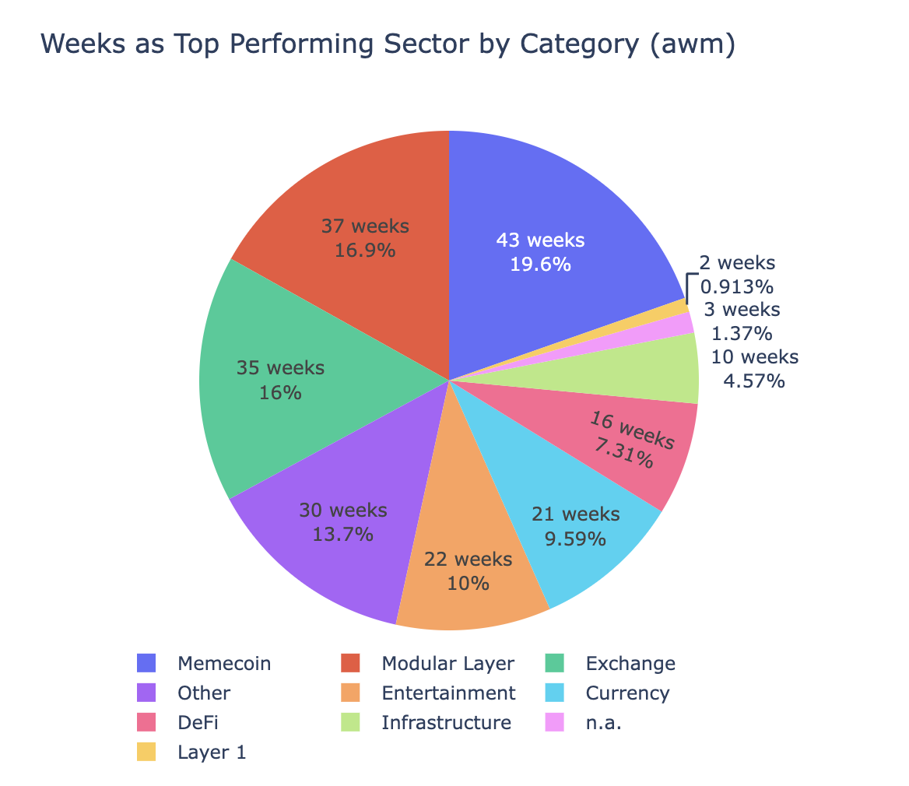
Returns using average weekly price (avg, med for category)

Slide 18
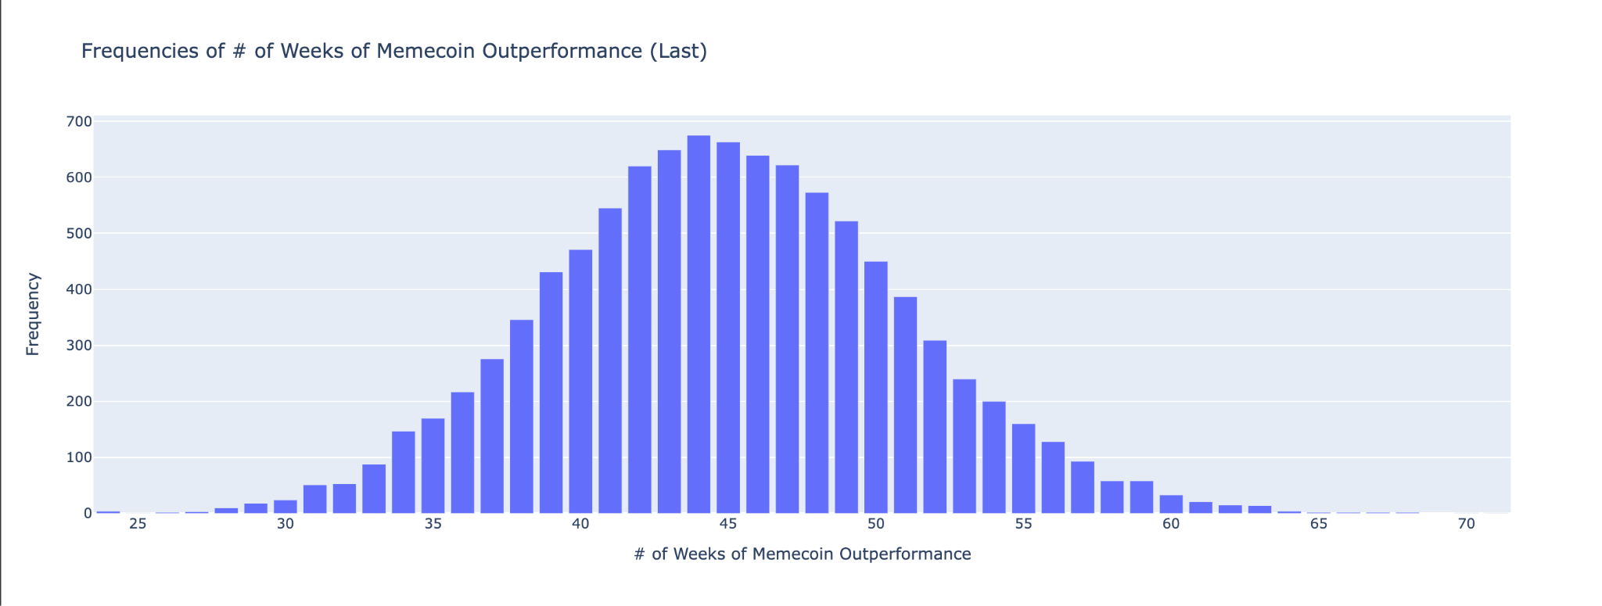
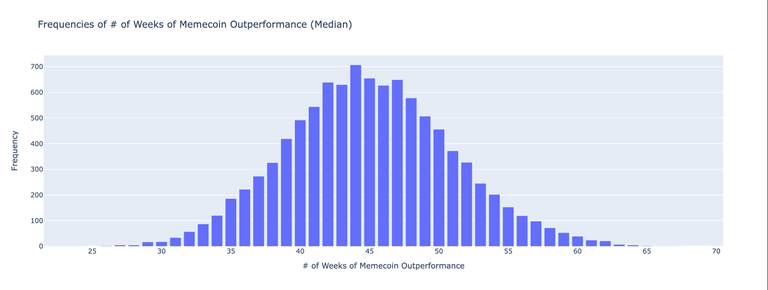
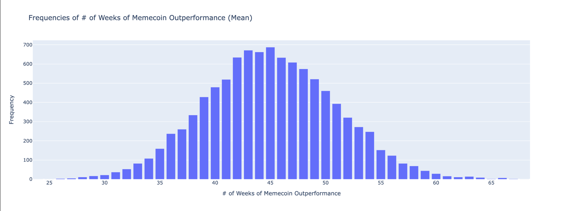
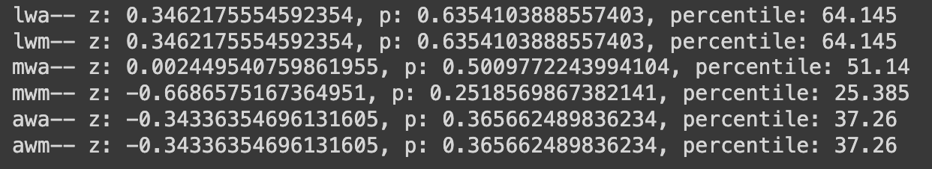
Is this sector outperformance normal/abnormal?
Simulation of 10,000
Normal sampling
Mean and std dev of all coin’s returns for the week
Resulted in a distribution with means close to 45 weeks in which ‘memecoins outperformed other categories’
Calculated z-score, p-value, and percentile for each # of weeks.
All very close to mean with high p-values (>>0.05) ⇒ fail to reject null hypothesis ⇒ top performance is ‘normal’

Slide 19
What market dynamics, if any, lead to memecoin outperformance? Do certain other categories (or the market as a whole) typically perform well before/after memecoins do?

Slide 20
Identifying Market Dynamics with Memecoin Outperformance
For all 12 methods of token returns, identify weeks in which the memecoin category produced higher returns than the market
Using that list of weeks, compare each coin before/after the week of outperformance with the memecoin category during the outperforming week
Identify correlations between the categories and memecoins with OLS
Sum the total number of statistically significant correlations for each coin over all 12 methods of coin returns (if there was a significant correlation with a certain coin throughout all measurements, it may be more ‘significant’ than one that only held for a couple of the measurements)
Repeat with multiple coins at a time

Slide 21
OLS: Memecoin Category vs All Other Categories (Before)
Testing other categories 1 week/month before occurrence of memecoin outperformance
The entertainment category had a significant correlation to memecoin outperformance in 9 different metrics
Entertainment |  |  | 9
DeFi | Other |  | 3
Currency | All | AllwoMC | 2
Currency | DeFi | Entertainment | 2
Currency | n.a. | All | 2
Layer 1 | n.a. | All | 2
Layer 1 | DeFi | Exchange | 2
*AllwoMC is the group that contains all coins except memecoins

Slide 22
OLS: Memecoin Category vs All Other Categories (After)
DeFi |  |  | 4
Currency |  |  | 3
Layer 1 |  |  | 3
Exchange |  |  | 3
DeFi | Infrastructure |  | 4
DeFi | n.a. |  | 3
DeFi | Entertainment |  | 3
DeFi | All |  | 3
DeFi | AllwoMC |  | 3
DeFi | Infrastructure | Layer 1 | 2
Testing other categories 1 week/month after the occurrence of memecoin outperformance
DeFi appeared many times throughout
Possible relation: After memcoins outperform, DeFi coins may perform well afterwards
*AllwoMC is the group that contains all coins except memecoins

Slide 23
OLS: Memecoins vs All Other Categories–Comparison to Expected Returns (Before)
Category comparison to its own expected performance
Entertainment presents itself again
Entertainment |  |  | 8
Exchange |  |  | 6
DeFi | Other |  | 4
DeFi | n.a. |  | 3
Currency | n.a. | All | 3
Layer 1 | n.a. | AllwoMC | 3
Currency | n.a. | AllwoMC | 2
*AllwoMC is the group that contains all coins except memecoins

Slide 24
OLS: Memecoins vs All Other Categories–Comparison to Expected Returns (After)
Category comparison to its own expected performance
Other categories checked week/month after memecoin category
Defi, Entertainment, etc
Exchange |  |  | 11
Entertainment |  |  | 9
DeFi | AllwoMC |  | 8
DeFi | Layer 1 |  | 7
DeFi | All |  | 7
Layer 1 | AllwoMC | n.a. | 5
Exchange | Modular Layer | Other | 4
DeFi | Currency | Layer 1 | 4
*AllwoMC is the group that contains all coins except memecoins

Slide 25
Possible Market Relations with Memecoins
The entertainment category demonstrated a correlation through a majority of the tested metrics. This could mean that the category often follows similar runs before memecoins
DeFi, by itself and with other groups, exhibited a correlation through lots of the ‘Afters.’ So, oftentimes DeFi will show a ‘correlated’ return after a week/month of memecoin outperformance

